Slide 1


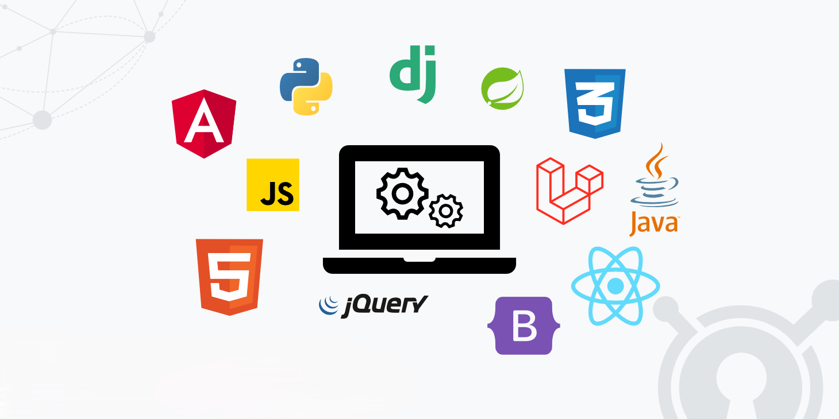

FULL
STACK DEVELOPER
KULBHUSHAN UPADHYAY

Slide 2
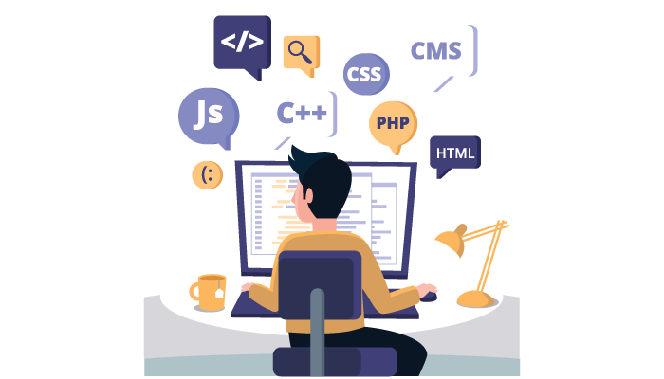
ABOUT FULL STACK DEVELOPER
A FULL-STACK DEVELOPER IS A DEVELOPER OR ENGINEER WHO CAN BUILD BOTH THE FRONT END AND THE BACK END OF A WEBSITE. THE FRONT END (THE PARTS OF A WEBSITE A USER SEES AND INTERACTS WITH) AND THE BACK END (THE BEHIND-THE-SCENES DATA STORAGE AND PROCESSING) REQUIRE DIFFERENT SKILL SETS.
FRONT-END DEVELOPER.
HTML and CSS are scripting languages used to create a web page and web applications. HTML provides web page structure, whereas CSS is mainly used to control web page styling.
React Js is a JavaScript library used to create user interfaces for web applications. It works together with HTML and CSS structurally by allowing developers to break up the application into components. These components are typically written in JSX, which is an XML-like syntax that combines HTML and JavaScript.

Slide 3


BACK-END DEVLOPER
The back end refers to parts of a computer application or a program's code that allow it to operate and that cannot be accessed by a user. Most data and operating syntax are stored and accessed in the back end of a computer system.. The backend communicates with the frontend, sending and receiving information to be displayed as a web page.
Back-end development means working on server-side software, which focuses on everything you can't see on a website. Back-end developers ensure the website performs correctly, focusing on databases, back-end logic, application programming interface (APIs), architecture, and servers
BACK-END LANGUAGE
PHP
JAVA
PYTHON

Slide 4


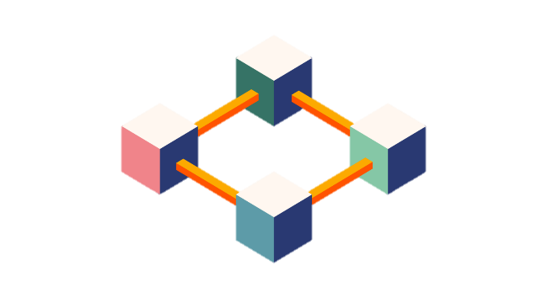


CURRENT TRENDS FULL STACK DEVELOPER
ARTIFICIAL INTELLIGENCE
MACHINE LEARNING
Blockchain
Cyber Security

Slide 5

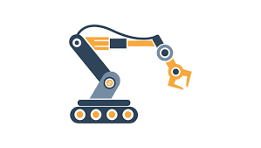


UPCOMING TRENDS
Low-code development
Automation
AGI = Artificial General Intelligence
CHAT BOT WITH MORE SUPER POWER

Slide 6


CAREER
ASPIRATIONS
CONSTANT GROWTH & SKILL ENHANCEMENT.
BECOME A MANAGER & LEADERSHIP OPPORTUNITIES
I am committed to staying updated with the latest trends and technologies in the industry. In the coming year, I plan to pursue specialized certifications and attend industry conferences to learn from experts.

Slide 7






LEARNING STRATEGIE
Effective Communication
Full stack developers often collaborate with both front end and back end teams. Being able to communicate clearly and work well with others is essential for project success.
Build Real-world Projects
Apply your knowledge by working on real-world projects. Build web applications that incorporate various functionalities and features.
Define My Learning Path
Identify the specific technologies, frameworks, and languages you want to master on both the front and the back. Having a clear roadmap will guide your learning journey.

Slide 8




WHY THIS COURSE
SKILLS MATCHE
CREATIVE MIND
BEST POSITION IN FUTURE
PASSIONATE ABOUR SOFTWARE & AI

Slide 9



LEARNING AT TOPS TECHNOLOGY
FRONT - END
BACK - END
HTML
C ++
CSS
C
JAVA SCRIPT
DATA BASE
BOOTSTRAP
JAVA
REACT JS

Slide 10



TECHNOLOGY
UPGRADATION
Technological advancement creates opportunities for companies that help them to run their business more efficiently. The latest devices and software help organizations and their employees do their jobs better and faster. Without up-gradation, most of the businesses waste time because of the old systems that are slow.

Slide 11

THANK
YOU

